Slide 1
CAPSTONE PROJECT

Slide 2


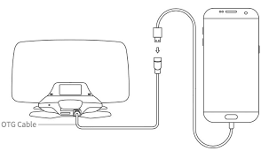
High level architecture view
JD API
MyJD
(file exchange)
JDLink Machine Data
(Equipment info)
HTTP/REST
HTTP/REST
JD Field Connect
(Field/Weather etc.)
...

Slide 3
iOS Apps
JD Farmer
Main functionality
JD Farmer Auto
Type: Audio
Handle voice commands while driving

Slide 4

JD Farmer
Pattern: MVC
Focusing on user experience and views of application gives the possibility of:
1. Fast prototyping
2. Always viewable software to present to the customer (even though technical side may still need development)
3. Fulfillment of majority of requirements at the beginning
4. By having a prototype we can narrow down which technical side needs to be studied
Notes:
From the grand scheme of architecture and the requirements presented by the John Deere, I think that it is good to use MVC as organization of our projects.
By taking into account that customer is mostly interested in overall experience in the car – I think that architecture drivers should be geared towards user experience and the views.
The reasons are provided on the next slide

Slide 5
JD Farmer Auto
Pattern: ?? Delegation

Slide 6
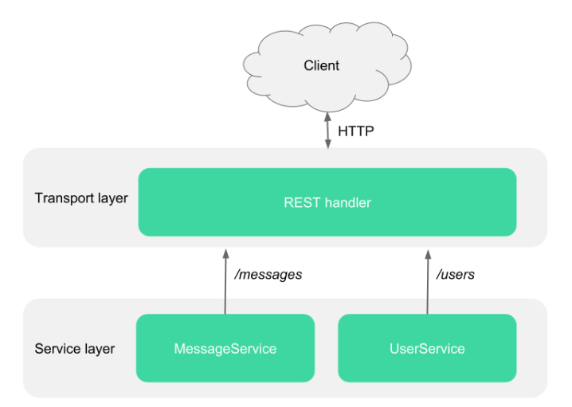
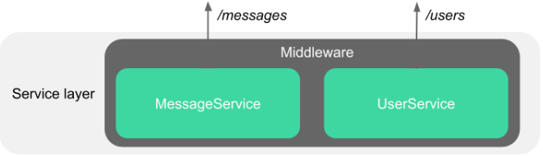
Gateway
Pattern: MIDDLEWARE
Separation of concerns
Possibility to add other protocols without changing logic
Testability
Additional functionalities:
logging
permissions
data preprocessing
other possible logics
https://blog.feathersjs.com/design-patterns-for-modern-web-apis-1f046635215

Slide 7
Technology
iOS Apps:
XCode, SWIFT
Gateway:
Eclipse/VS Code, Java, … to be defined

Slide 8
General plan
11th of Oct: Have a list of Drivers drafts
14th of Oct: Have a list of Drivers solutions drafts
18th of Oct: Main Design Decisions drafted
21st of Oct:
Prototype is ready to demonstrate
SW Architecture document v.0.1
Technologies, Design Patterns finalized
22nd of Oct: Sprint REVIEW
25th of Oct:
SW Architecture doc v.0.2
Have a list of high priority Data & Functions
Activities identified: responsibilities in development distribution (team-module mapping)
Detailed Architecture Design created

Slide 9
TO SUMMARIZE
While thinking of how architecture and development of software should go we tried to answer the following questions:
1. On 22nd October will we have something to show to the client, even though the data is just dummy - Prototype
2. We also accept the risk that not all requirements will be fulfilled in 10 weeks' time so on final presentation on 20th of December, people will definitely be more concerned about WHAT the application does and not HOW it does. So sacrificing a bit of speed or huge data consumption should not be the obstacle.

Slide 10
THANK YOU FOR LISTENING

